Slide 1
Dispensational Truths (Part 2) different ways of studying the bible
April 2020
Rev Keith Gentry

Slide 2
Dispensational truths:
1 Corinthians 9:17 For if I do this thing willingly, I have a reward: but if against my will, a dispensation of the gospel is committed unto me.
Ephesians 3:2 If ye have heard of the dispensation of the grace of God which is given me to you-ward:
Dispensation means administration.
A dispensation is a period of time during which God deals in a particular way with man in respect to sin and mans responsibility. (Time period, responsibility, failures & consequences. God moves)
During a dispensation man is tested :-
In respect of obedience and
To some specific revelation of the will of God
So with COVID -19 are we in a time of crossing over from Grace to Tribulations, some say the church would not see tribulation, is COVID -19 a tribulation?

Slide 3
Dispensational truths: continued
Well Spanish flu (N1N1) was from 1918 to 1920 killed globally 40 – 100m deaths
There are end time revival verses within the bible.
Haggai 2:7 -9
For thus saith the Lord of hosts; Yet once, it is a little while, and I will shake the heavens, and the earth, and the sea, and the dry land;
⁷ And I will shake all nations, and the desire of all nations shall come: and I will fill this house with glory, saith the Lord of hosts.
⁸ The silver is mine, and the gold is mine, saith the Lord of hosts.
⁹ The glory of this latter house shall be greater than of the former, saith the Lord of hosts: and in this place will I give peace, saith the Lord of hosts.

Slide 4
Dispensation of Innocence (Edenic)
Timescale (random) | Man’s Responsibility | Man’s failure & the consequences | Observations
Not known – begins with the creation of man – ends with the fall of man | Man disobeys God’s word and chooses to follow the lie of the statements of Satan | a) Man, choses to believe Satan b) Which ended with Judgement on mankind, the earth and Satan c) The necessity of the saviour is seen, and the promise of a saviour is given | Man was created in innocence, walked with God. Simple test of Obedience. Man choose to be disobedience, which lead to death. God provided Mercy – the blood / animal skins. Promise of a saviour. Expulsion from Eden.
Gen Ch 1-3 Paradise Lost Gen Ch 3:24 ‘So he drove out the man’

Slide 5
Panorama study:

Slide 6
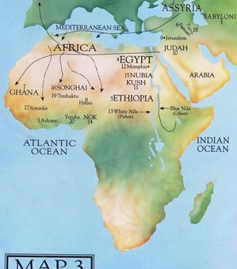
Origination of where man started / or where is Eden?
Gen 2: 10- 15
1st river is Pison (White Nile) whole land of Havilah, where there is gold.
2nd river Gihon – (Blue Nile) Ethiopia
3rd river Hiddekel towards East Assyria (Tigris)
4th river Euphrates
*Remember the World looked different before, the dispensation of human government

Slide 7
Timescale (random) | Man’s Responsibility | Man’s failure & the consequences | Observations
From the fall of man to the flood – 1656 years | Man had a simple choice between doing good or doing evil. He insisted on evil. | a) Man proved to be exceedingly wicked and the consequences was b) Judgement through the flood. | Faith, worship, hope & sacrifice is carried over to conscience. Cain – indifferent heart went his own way. 1st Murder . Renewed righteous seed in Seth. Noah called men to repentance. 8 Souls saved from the Flood.
Gen Ch 3-7 Cain and Abel, Generations of Seth, wickedness of the world, seed of righteous persevered, the Flood
Dispensation of Conscience
(*Antediluvian)
* Ancient

Slide 8
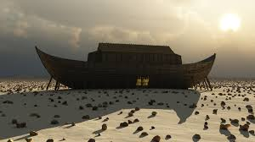
Conscience – Adam to Noah 3 sons Gen 5
Noah preaches righteousness, builds the ark
and warns of the coming Judgment.
2 Peter 2: 5
1 Peter 3: 18-20
Cain
As men multiplied ‘iniquity abounded’
Until the earth was corrupted Gen 6: 1-13
Gen 4: 1-16
Noah
Shem
Here begins the path
of the seed of the
Promised redeemer
Gen 3:15
Abel
Seth
Gen 4:25
Enos, Cainan, Mahalaleel, Jared, Enoch, Methusalah, Lamech
Ham
Japheth
Cain & Abel. Generations of Seth. Wickedness of the world (Gen Ch 3-7.) Seed of the righteous . The Flood

Slide 9
Timescale (random) | Man’s Responsibility | Man’s failure & the consequences | Observations
From the Flood to confusion of tongues at Babel – 427 years | Noah was given the responsibility to govern for God | a) Noah revealed that man is unable to govern himself and therefore unable to govern others. b) The building of the tower Babel was an organised political and religious rebellion against God. c) Judgement. The consequences of man’s failure was the confusion of tongues and the dispersion of the people | The Flood – Noah’s first act was offering a great burnt offering. Gods’ covenant pledge set a rainbow in the heavens for perpetual generations.
Gen Ch 8 – 11 Gods covenant with Noah, Re-peopling the Earth, through Ham, Shem and Japheth, Babel, Dispersion
Dispensation of Human Government (*Postdiluvian)
* Post flood or Deluge

Slide 10
Gen 8:4 The ark rests on Mts range of Ararat.
(Turkey / Armenia)
“Let us go down and confound them and scatter them” Gen 11: 5-9
The dispersion Gen 11: 1-9
HAM
Africa & Arabia
Cush
Mizram
Phut
Canaan
Gods covenant
Hamitic
Palestine
Noah
Shem
Elasm
Asshur
Arphaxad
Lud
Aram
Assyria
From Arphaxad descended the Hebrew race
Semitic
“Be fruitful, &
multiply &
replenish the
Earth” Gen 9:1
Japheth
Gomer
Magog
Madal
Javan
Tubal Meshech
Tiras
Asia Minor & Europe
and by these were the nations divided in the earth “ Gen 10:32
Japhetic
Human Government

Slide 11
Timescale (random) | Man’s Responsibility | Man’s failure & the consequences | Observations
From the call of Abraham to Exodus 430 years | Abram - Abraham was to stay in the land that God had given to him, and not go down into Egypt which is a type of the world. Gen 12:10 Abram Gen 26:2 Isaac go not down to Egypt | a) Abram doubted God’s word and went down to Egypt for food. b) Finally all of Jacobs’s house went down to Egypt. The result was slavery in Egypt, sin & idolatry. c) Divine mercy is seen in the deliverance and preservation of Israel | Ham, founded an empire of the Euphrates, son of Ham founded the Egyptian empire. Idolatry – dominated the earth. Abram chosen to leave Ur of the Chaldees, leave his father Tarah, (delay.) Abram received the promise and covenant A new start for the Kingdom of God. Abram impatient with Sarai. Took Hagar a bond maid. – Ishmael, father of the Arab race. Abraham & Sarah in their old age received the promise again and a miraculously birth of. Isaac inherited his father faith. 2 son=s Esau sold his birth right –(Enormities) to Jacob. Name change to Israel “ A prince with God”. 12 sons. Joseph was blessed and hared by his brothers. Sold to the Midianites and sold into Egypt an became a governor of Egypt and eventually Jacob and family settled in Egypt. In this dark era of Israel, a son was born to Moses. Who after 40 years left Pharaoh’s palace, 40 yrs in the wilderness and returned. To lead his people towards the promise land. The fourth dispensation (promise) ended in bondage and oppression.
Genesis 11:10 -15:21 Call of Abram, Isaac, Jacob, Children of Israel (Jacob), Egypt, Bondage, The Exodus Gen 12 -40, Exodus 1-12
Dispensation of the promise (*Patriarchal)
* Male government controlled

Slide 12
Promise observations: A lot happened in 430 years
Ham, founded an empire of the Euphrates, son of Ham founded the Egyptian empire.
Idolatry – dominated the earth.
Abram chosen to leave Ur of the Chaldees, Instructed to leave his father Terah, (delay.)
Abram received the promise and covenant
A new start for the Kingdom of God.
Abram impatient with Sarai. Took Hagar a bond maid. – resulted in Ishmael, father of
the Arab race.
Abraham & Sarah in their old age received the promise again and a miraculously birth of
Isaac inherited his father faith. Twins, 2 son’s, Esau & Jacob, Esau sold his birth right
to Jacob. Jacobs name change to Israel “A prince with God”. He has 12 sons.
Joseph was blessed and hated by his brothers. Sold to the Midianites and sold into Egypt,
The dreamer helped Egypt in a time of famine. He became a governor of Egypt and
eventually Jacob and family settled in Egypt.
In this dark era of Israel, Egyptian slavery and male children being killed, Moses was born.
Moses found in the bulrushes of the River Nile by Pharaohs barren daughter who adopted
Moses after 40 years left Pharaoh’s palace, 40 years in the wilderness and returned.
To lead his people towards the promise land.
The fourth dispensation (promise) ended in bondage and oppression.

Slide 13
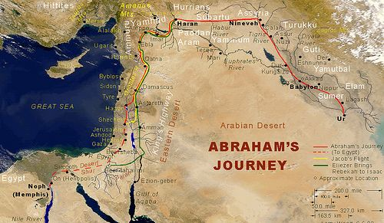

Slide 14
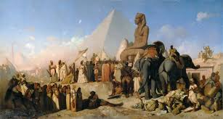
Ethiopians – descendants of Cush
Phoenicians and Canaanites - dansants of Canaan
Hamitic
Libyans – Descendants of Phut
The call of Abram, to leave the Ur of the Chaldees
Reuben
Simeon
Levi Num 3:5-12
Judah
Issachar
Zebulon
Joseph
Benjamin
Dan
Naphtali
Gad
Asher
Semitic
ESAU - Edomites
Abram
Isaac
Jacob
Israel
House of Jacob arrive in Egypt Gen 46:27
Ishmael Gen 17: 20
The Arab race
“Now these are the names of the children of Israel which came
into Egypt with Jacob Ex 1:1-5”
Japhetic
Gauls, Britons, Germans, Russians, Medes, Iberians, Greeks, Romans, Thracians
Judah first called Jews after the Babylonian captivity
The Exodus Ex Ch 12
Promise

Slide 15
Timescale (random) | Man’s Responsibility | Man’s failure & the consequences | Observations (Part one)
From Sinai to Calvary - from the exodus to the cross 1491 years | Israel was to keep the Law which included the Ten Commandments and all the social and civil laws. | a) Man failed to keep the Law. b) The only one who kept the Law, (was Jesus) they ( the Jews -Israel) crucified Him by the Romans crucifixion. | 10 national plagues in Egypt to overcome Pharaoh. Passover was instituted & celebrated (The Blood.) Ex 12:40 sojourned in Egypt 430 yrs. Gal 3:17 the Law was given for 430 yrs Sinai – Moses given the Ten Commandments instructions for the Tabernacle. Arranged into 12 Tribes, moved towards the Promise Land. Moses at Kadesh Barnea sent 12 spies. Num 13-14 (10 reports full of fear & 2 Faith reports.) Num 13:30 Caleb stilled the people and said “Let us go up at once” Due to Israel’s unbelief, for the next 40 years, the Israelites over 20 Years old wondered in the wilderness until death. After 38 years they arrived at Kadesh, the scene of their father’s tragic unbelief. Moses Deu 1 in the land of Moab, repeats the Law, rehearsed the promises, blessings and prepares their entrance into Canaan. Moses then dies, without crossing Jordan. After the death of Moses Deut 34. Joshua leads the children of Israel across the Jordan and onward to Canaan - Jericho. (Walls come tumbling down.) Israel continues to backslide. Then the time of Judges, then the people called for a King. Moved from Theocracy to Monarchy. King Saul is selected. – 40 years of self-will and impulse. Then came along King David. One of the faithful good men of the OT. Then Solomon reigned 40 years. “the golden age of Israel”. – building the Temple.
Red Sea, Sinai, Wilderness Journey, Death of Moses, Conquest of Canaan, Theocracy to Monarch
Exodus, Leviticus, Numbers, Deuteronomy, Joshua, Judges, 1 & 2 Samuel 1 & 2 Kings
Dispensation of the Law
(Legal)
Part one

Slide 16
The Law: Observations (Part 1) from the book of Exodus to Kings
10 National plagues in Egypt to overcome Pharaoh. The Passover was instituted & celebrated (The Blood.) Ex 12:40 sojourned in Egypt 430 yrs. Gal 3:17 the Law was given after the 430 years. ----------------------------------------------------------------------------------------------------------------------------------- Sinai –Moses given the Ten Commandments, the instructions for the Tabernacle. Israel arranged into 12 Tribes, and moved towards the Promise Land. Moses at Kadesh-Barnea sent 12 spies. Num Ch 13-14 (10 reports full of fear & 2 reports full of faith.) Num 13:30 Caleb stilled the people and said “Let us go up at once” Due to Israel’s unbelief, for the next 40 years, the Israelites (those over 20 years old) wondered in the wilderness until death. After 38 years they returned to Kadesh, the scene of their father’s historic tragic unbelief. Moses Deut 1 reaches the land of Moab, Moses repeats the Law, rehearses the promises, blessings and prepares their entrance into Canaan. Moses then dies, without crossing into Jordan. After the death of Moses Deut 34. Joshua leads the children of Israel across the Jordan and onward to Canaan - Jericho. (The Walls come tumbling down.) Israel continues to backslide. Then the time of Judges (300 yrs) then the people called for a King. Israel moved from Theocracy to Monarchy. King Saul is selected. – 40 years of self-will and impulse. Then came along King David. One of the faithful good men of the OT. (Saul, David, Solomon – United Kingdom.) Then Solomon reigned 40 years. “the golden age of Israel”. – building the Temple.

Slide 17
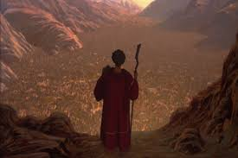
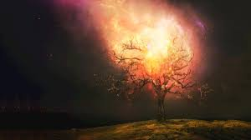
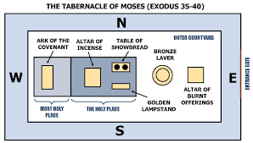
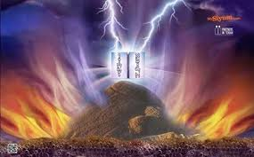
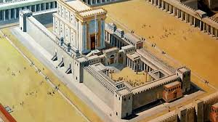
Fifth Dispensation The Law of Moses (Moshe Rabbenu -Moses our teacher) the Torah -
Gen 10: 15 -20 Jebusite, Amorite, Girgasite, Hivite
The invasion – conquest & Division of Canna
Joshua
Jordan then Jericho Joshua Ch 1-2
Moses
The Judges
KadeshBarnea
Num Ch13-14
Israel demands a King
Red Sea
Marah
Elim
Rephilim
Saul
(1st King)
Burning bush
40 years of the
wilderness& miracles
David
Death of Moses Deut 34
Solomon
Sinai

Slide 18
The Law: Observations (Part 2), The book of Kings to Daniel
The Kingdom Divided ( Revolt), Israel and Judah, Captivity and the End of the Kingdoms, The Decree of Cyrus – ( Ezra 1)
Israel – 1 & 2 Kings, 2 Chron, Judah – 1 & 2 Kings – 2 Chron, Isaiah, Jeremiah. The Captivity – Jeremiah – Ezekiel – Daniel
The whole earth sought Solomon’s wisdom that God had put into his heart.
God anointed him to bare record of Jehovah, the one true God. He sought divine guidance & wisdom above all else. He followed the example of other kings, & put burdens on his people
& had 700 wives & 300 concubines. Following self –indulgence, he suffered revolts.
At the coronation of Solomon’s son Rehoboam, the people asked for Solomon burdens to be lightened, Rehoboam instead increased the burden on his people, there was another revolt by the people, Rehoboam feared for his life and fled to Jerusalem. Jeroboam, of the tribe of Ephraim stood forward to lead the people, with the exception of Judah & Benjamin and later the Levites.
There was 60 years of warfare, both kingdoms weakened and ended up into captivity.
The Kingdom Israel lasted for 250 years and overcome by the Assyrian Empire.
The Kingdom of Judah lasted another 135 years after the fall of Israel. Its’ history was marked by various revivals which reflected on the spiritual life of certain kings. Eventually “Judah also did evil in the sight of the Lord” 2 Kings 21: 2-16. King Nebuchadnezzar took them into captivity & destroy Solomon's Temlpe.

Slide 19
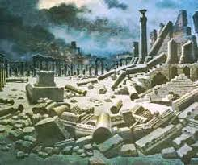
The Law continued
*13 “Man of God” in the Bible
Northern Kingdom. Israel (Ten Tribes) Capitol Samaria
(19 Kings from 9 families / dynasties (about 250 years)
Jeroboam
1
The Captivity Assyria
2 Kings 17
1) Jeroboam 2) Nadab 3) Baasha 4) Elah 5) Zimri
6) Omri 7) Ahab 8) Ahaziah 9) Jehoram 10) Jehu
11) Jehoahaz 12) Joash 13) JeroboamII 14) Zachariah 15) Shallum
16) Menahem 17) Pekahiah 18) Pekah 19) Hosea
Revolt of ten tribes
1 Kings Ch 12
The Prophets – *Man of God . Ahijah. Elijah. Micaiah. Elisha. Jonah. Hosea. Amos. Oded
The Kingdom Divided
1 Kings 11:26 -40 –Ch12
1) Rehoboam 2) Abijah 3) Asa 4) Jeshoshaphat 5) Jehoram
6) Ahaziah 7) Athaliah queen 8) Jehoasa 9) Amaziah 10) Uzziah
11) Jotham 12) Ahaz 13)Hezekiah 14) Manassen 15) Amon
16) Josiah 17) Jehoahaz 18) Jehoiakim 19) Jehoiachin 20) Zedekiah
Temple destoyed
Rehoboam
1
Babylon
70 Years Captivity
2 Kings 25
The Southern Kingdom . Judah (Two Tribes) Capitol Jerusalem
(19 Kings 1 Queen All of David Dynasty about 400 years)
The Prophets – Shemaiah. Iddo. Azariah. Hanani. Jehu. Eliezer. Jahaziel. Zechariah 1&11. Isaiah . Micah .Nahum. Joel. Jeremiah. Habakkuk. Zephaniah. Ezekiel. Daniel. Obadiah. (post exile Haggai. Zech. Malachi)

Slide 20
The Law: Observations Part two,
Questions: What makes a good King or Queen? How many good Kings & Queen’s are there in this part of history of the Dispensation of the Law? 39 15 5 8 And Who are they?

Slide 21
The Law continued
*13 “Man of God” in the Bible. (example -1 Kings 13:1)
Northern Kingdom. Israel (Ten Tribes) Capitol Samaria
(19 Kings from 9 families / dynasties (about 250 years)
Jeroboam
1
The Captivity Assyria
2 Kings 17
1) Jeroboam 2) Nadab 3) Baasha 4) Elah 5) Zimri
6) Omri 7) Ahab 8) Ahaziah 9) Jehoram 10) Jehu
11) Jehoahaz 12) Joash 13) JeroboamII 14) Zachariah 15) Shallum
16) Menahem 17) Pekahiah 18) Pekah 19) Hosea
Revolt of ten tribes
1 Kings Ch 12
The Prophets – *Man of God . Ahijah. Elijah. Micaiah. Elisha. Jonah. Hosea. Amos. Oded
The Kingdom Divided
1 Kings 11:26 -40 –Ch12
5 good kings out of 39 Kings incl one queen
1) Rehoboam 2) Abijah 3) Asa 4) Jeshoshaphat 5) Jehoram
6) Ahaziah 7) Athaliah queen 8) Jehoasa 9) Amaziah 10) Uzziah
11) Jotham 12) Ahaz 13) Hezekiah 14) Manassen 15) Amon
16) Josiah 17) Jehoahaz 18) Jehoiakim 19) Jehoiachin 20) Zedekiah
Rehoboam
1
Babylon 70 Years Captivity
2 Kings 25
The Southern Kingdom . Judah (Two Tribes) Capitol Jerusalem
(19 Kings 1 Queen All of David Dynasty about 400 years)
The Prophets – Shemaiah. Iddo. Azariah. Hanani. Jehu. Eliezer. Jahaziel. Zechariah 1&11. Isaiah . Micah .Nahum. Joel. Jeremiah. Habakkuk. Zephaniah. Ezekiel. Daniel. Obadiah. (post exile Haggai. Zech. Malachi)

Slide 22
The Law: Observations (Part 3) From the restoration to
the end of the Old Testament
During the time of the captivity, the great Babylonian Empire came to an end by the co-partnership of the Medes-Persian Empire. Cyrus the founder of the partnership Belshazzar King of Babylon was slain and Darius the leader of the Medes took the throne. After 2 years Darius died. Cyrus took the throne & became the ruler of Babylon. Daniel ends up in the Lions den, after his miraculous deliverance he is able to approach the new king, and showed him the prophecies of Isaiah about himself being God’s instrument for the release of the people. Greatly impressed he set a decree to allow the Israel to return to Jerusalem to build the temple. Daniel 9: 24-27.
The return of the Jews from Babylon in three separate missions.
1st Under Zerubbabel prince of Judah 50,000, repaired the altar & restored worship
The Samaritans refused to work, hindered and stopped the work by an order of King Artaxerxes. After 16 years interval. Haggai and Zechariah stirred up the people to finish the work.
2nd Led by Ezra the scribe, 78 years after Zerubbabel's return. Ezra zeal re-establishing Moses Law, he gained permission from the king to return with a small group of pilgrims.
He found immoralities and abuse, for 3 months he stirred up the people, and brought about a reformation in Jerusalem.
3rd Nehemiah, a Jew of captivity, found favour with the Kings of Persia. Messages from Jerusalem with an appeal to Nehemiah for help, his heart was touched and obtained permission from the king to return to Jerusalem to rebuild the walls in 52 days.

Slide 23
400 years of silent. A faithful few held onto the oracles of God gathered by Ezra, The Law, The prophets & the Psalms
The post-captivity period – The books of Ezra. Nehemiah. Haggai. Zechariah. Malachi
Isaiah 11:11-16 Remnant Assyria, Egypt, Pathos, Cush, Elam, Shinar & Hamath
The Captivity Assyria
2 Kings 17
Israel (Isaiah 10:20–22).
The Restoration of the Remnant
Historically periods
The Persian
The Greeks
Jewish independence
Romans
The OT ended in Persian rule & the NT opened under Roman rule
Nehemiah
The post-captivity prophets Haggai. Zechariah & Malachi
The last of the Old Testament prophets
Ezra
Zerubbabel
Babylon 70 Years Captivity
2 Kings 25
The three missions:
Zerubbabel – 536 BC.
Ezra- 78 yrs later 458 BC
Nehemiah – 14 years Later 444 BC

Slide 24
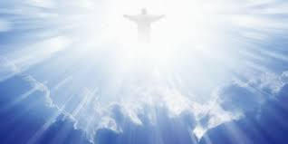
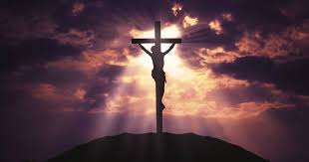
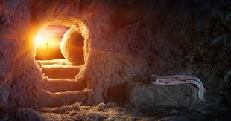
The Law ended at Calvary. The 5th Dispensation ends in Judgement of Sin at Calvary
“It is finished”
Crucifixion
Ascension
Bethlehem
The Birth of Jesus
Betrayal arrest trial
* 30 years old
The Baptism of Jesus
The triumphal entry
Matt Ch 1-2
Matt Ch 26
-27:1-26
Olivet
Matt Ch 27: 27-66
Acts 1:1-14
Resurrection
Matt Ch 3
Christ’s earthly ministry
Matt 21: 1-17
Birth of Jesus
before the
death of Herod
Matt Ch’s 4 –
Ch 25
Matt Ch 28
Beginning of the New Testament. Birth – Ministry – Death – Resurrection & Ascension of Jesus Christ

Slide 25
Timescale (random) | Man’s Responsibility | Man’s failure & the consequences | Observations
From Pentecost to the rapture of the church | Man to believe in and accept the Lord Jesus Christ as Saviour and to obey the gospel. Set up the Church. Acts 2:38 & more Repent Be Baptised in the name of Jesus Receive the gift of the Holy Spirit. Progress in the ministry. The 9 gifts of the spirit will empower the church. Live a righteous life until the return of Christ | a) Man becomes a lover of himself, money, pleasure and a rejector of Jesus Christ. b) The result is that God gives them up to unbelief and eternal judgement c) The Church (1 Cor 11:23-26 Lords Super ) are raptured away before the Tribulation | After the ascension the disciples returned to Jerusalem to wait for the Promise of the Holy Spirit. 120 believers. Acts 2. Pentecost is 50 days after the crucifixion/ Passover. The Apostolic Church starts with three areas. 1) Christianity among the Jews lead by Peter. 2) Christianity among the Greeks, Romans (Gentles) lead by Paul. 3) And the consolidation of Jewish and Gentile lead by John who survived all other apostles. Grace ends with the rapture of the Church 1 Thes 4: 13-18. (ekklesia – called out ones.) The living and the resurrected saints “caught up”. We shall not all sleep.
Descent and dispensation of the Holy Spirit. (The Church Age) Rapture
Acts of the Apostles. Matthew Ch 24 -25. 1 Thess 4: 13 -18 Revelations
Dispensation of Grace (The Church Age)

Slide 26
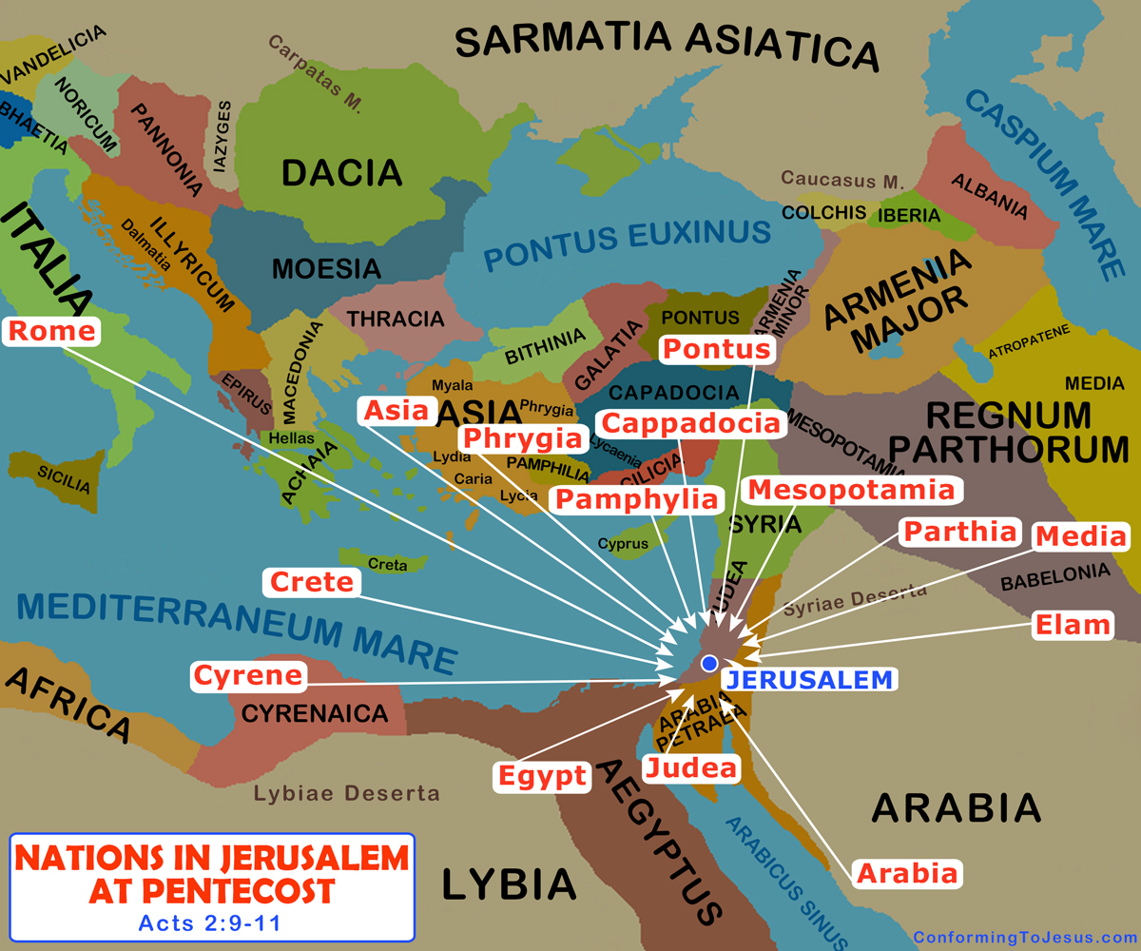
Ham
Shem
Japheth

Slide 27
Eschatology: The study of the last days
Some key facts / observations about the last days….
Nobody knows the timing, there is no warning, there is no biblical coding when the Rapture & the Resurrection of the dead will happen. (There are only the factual signs that identified in Matthew 24 & other biblical references: which should be enough of a clue.)
There are more references in the bible to Christ 2nd coming than to his birth. (It’s real.)
When the church meets Christ in the air . (There is no time to get ready, it will just happen, in a twinkle of an eye) drop the mic! (This is the last day of the dispensation of Grace, hopefully we are not left behind.)
Don’t’ waste your time on conspiracy theories & social media, 2 Thess 2:3 “Let no man deceive you” it will take your eye off what we are meant to be doing now. (Here are some clues, Passover, Noah, 10 Virgins, Haggai “consider your ways”… ‘They will come’ Haggai 2:7. (Heb 10:25) see the day approaching, Daniel Ch7 & Ch9, Rev13, The epistles to the Thessalonians etc…. We should be getting ourselves right and saving the lost.
All of the technology, the monetary systems, the political, ‘religious’ systems will be in place, or in prototype form, to be established & working before or after the dispensation of Grace. (We cannot stop it, perhaps we can slow it down with our prayers)

Slide 28
Type of sign | ‘The What’ | Scripture ref | ‘The when’ | Which dispensations ref
Moral | Days of Noah | Matthew 24:37 | Last days | Conscience & Grace
Moral | Days of Lot | Luke 17: 28-30 / Jude 1:7 | Last days | Promise & Grace
Political | Revival of the nation of Israel | Ezekiel Ch 37 | Last days | Law & Grace
Political | The rise of Gog & Magog (See Map old USSR Uzbekistan – mosques) | Ezekiel Ch 38 & 39 | Last days | Human Government, Law & Grace
Political | Gentile world government | Daniel 7 | Last days | Law & Grace
Physical | Natural disturbances | Matthew 24:7 | Last days | Grace
Physical | Manmade disturbances | Matthew 24:7 & 15 | Last days | Grace
Observations: General events & signs of the last days, before the dispensation of Tribulation / before the Rapture

Slide 29
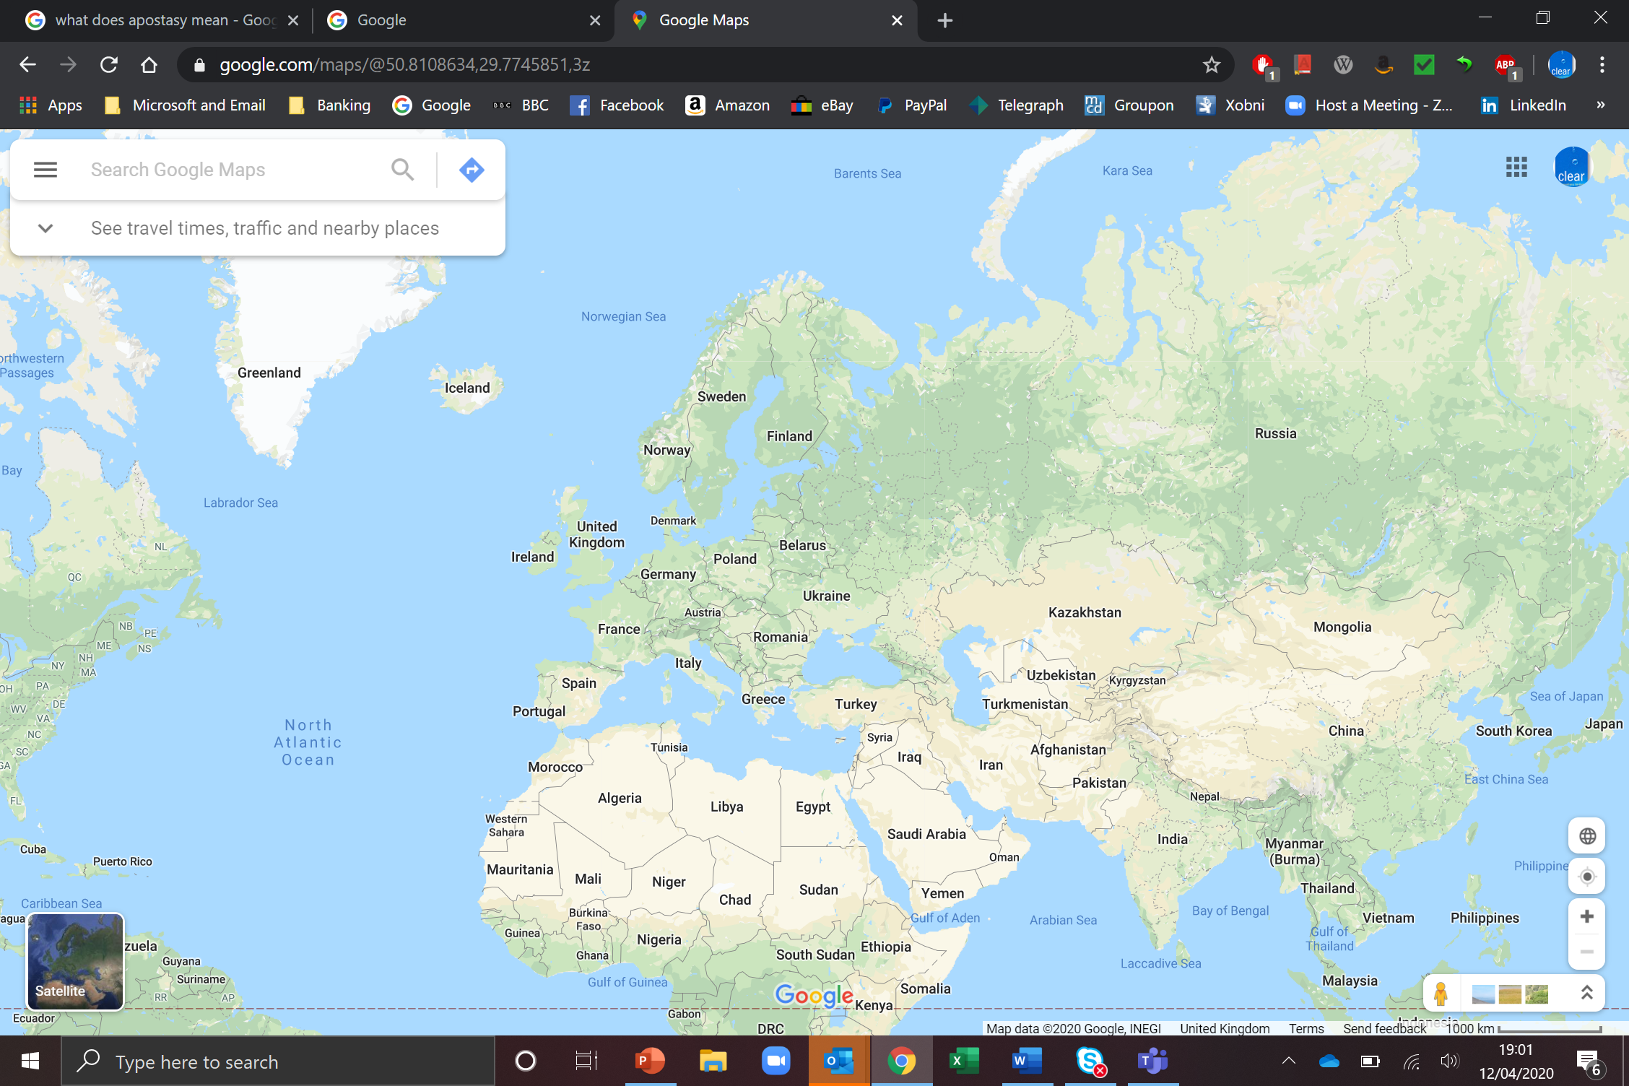
The Russian-dominated Soviet Union grew into one of the world's most powerful and influential states and eventually encompassed 15 republics–Russia, Ukraine, Georgia, Belorussia, Uzbekistan, Armenia, Azerbaijan, Kazakhstan, Kyrgyzstan, Moldova, Turkmenistan, Tajikistan, Latvia, Lithuania, and Estonia...

Slide 30
Type of sign | ‘The What’ | Scripture ref | ‘The when’ | Which dispensations ref
Spiritual | Apostasy | 2 Thess 2:3 Dan 7:25/ 8:25/11:36 | Last days | Law & Grace
Spiritual | Satanism & demon worship. Antichrist | 1 John 4:4 / 1 John 2:18 | Last days | Grace
Spiritual | Pleasure & addictions | 2 Timothy 3: 1-8 | Last days | Law & Grace
Spiritual | Worship of creature instead of creator | 2 Timothy 3: 1-8 Rev Ch 13 | Last days | Grace
Spiritual | Humanism & New Age – Paganism | 2 Timothy 3; 1-8 Jude 1:7 | Last days | Law & Grace
Observations: General events & signs of the Last days, before the dispensation of Tribulation, before the Rapture continued

Slide 31
Luke 21:36 Watch ye therefore, and pray always, that ye may be accounted worthy to escape all these things that shall come to pass, and to stand before the Son of man.”

Slide 32
Considerations:
Opinions: a view or judgement formed about something, not necessarily based on fact or knowledge.
Facts: a thing that is known or proved to be true.
Assumptions: a thing that is accepted as true or as certain to happen, without proof.
Bias: an inclination or prejudice for or against one person or group, especially in a way considered to be unfair.

Slide 33
Observations around the dispensation of tribulations
In the most part Christians believe in 3 possible raptures sequences.
(To be fair nobody knows for sure.)
There are teachings on Pre-tribulation / Mid-tribulation / Post tribulation.
In this lesson I am only going to review Pre tribulation sequences of events
Tribulation is the judgement of Christ- rejected Gentile nations as well as Christ-rejected Israel. Rev 3:6-12 – (Philadelphia) “ the time of Jacobs’ trouble” Jeremiah 30:7’
God has always protected His people before judgement fell.
“Who” & “How” | Which Judgement | Type | Dispensation ref
Enoch - translated | Before the flood | Church | Conscience
Noah & family were kept from danger | The ark saved Noah from the flood | Type of the nation of Israel | Conscience / Human government
Lot taken in the nic of time | Before Sodom & Gomorrah | Church | Promise / Grace – 2 Peter 2:7

Slide 34
Timescale (random) | Man’s Responsibility | Man’s failure & the consequences | Observations
From the rapture of the Church to the start of the Millennium | Man is to recognise and worship God; he is to refuse to take the mark of the beast | Man is to recognise and worship God; if he refuses to take the mark of the beast. Can only trade with the mark of the beast. | The manifestation of the Antichrist, a short reign. The last half of Daniel’s 70th week or three and a half years. Rev 11:2-3. 2 Thess 2: 1-8. With the climax of hate and bloodshed at the great Battle of the Armageddon. Daniel 9:27. Rev 16: 16-19. They shall see the son of man coming in the clouds of heaven with power & glory Dan 7: 13-14 Mathew 24: 29-30 . The armies of the Antichrist shall be destroyed. The Devil ‘ that old serpent’ shall be bound and imprisoned for a thousand years. Rev 20: 1-7
Dispensation of Tribulation

Slide 35
The Antichrist: In the dispensation of Tribulations
Antichrist will exist in the world and lay his plans before the Rapture of the Church (Revelations 13 is basically in play with the set up with a Global political, economical, and ecclesiastical. Mark of the Beast 666. Demonic wonders.
(Daniel prophecy of 70 weeks, in the 70th week, a period between the Rapture and the second coming of Christ to earth Daniel 9:27.)
The Antichrist will confirm the Mosaic covenant with the Jews for 7 years, allowing Levitical sacrifices and oblations (Daniel 9:27.) In the middle of the 7 years the Antichrist will break his covenant with the Jews and cause the Temple worship to ceases. (Isa 28:18 & Daniel 9:27.)
The Antichrist will now focus on Israel tribulation no one will be able to buy or sell with out the mark of the beast. Rev Ch 13 He shall have power over of gold and silver. Daniel 11:43. Then the armies of the world will assemble at the campaign of Armageddon. Daniel 12: 1-5. Rev 16:16. Rev 19: 17-21. Located east of Mt Carmel the north part of Canaan. (Napoleon called this plain “the worlds most natural battlefield, there was enough room for the armies of the world to manoeuvre.”)
The 2nd Coming of Jesus Christ Matthew 24:27 & 30/ Isaiah 34:2 Zech 14: 2-4; Jeremiah 25:33 set up his kingdom for 1000 years.

Slide 36
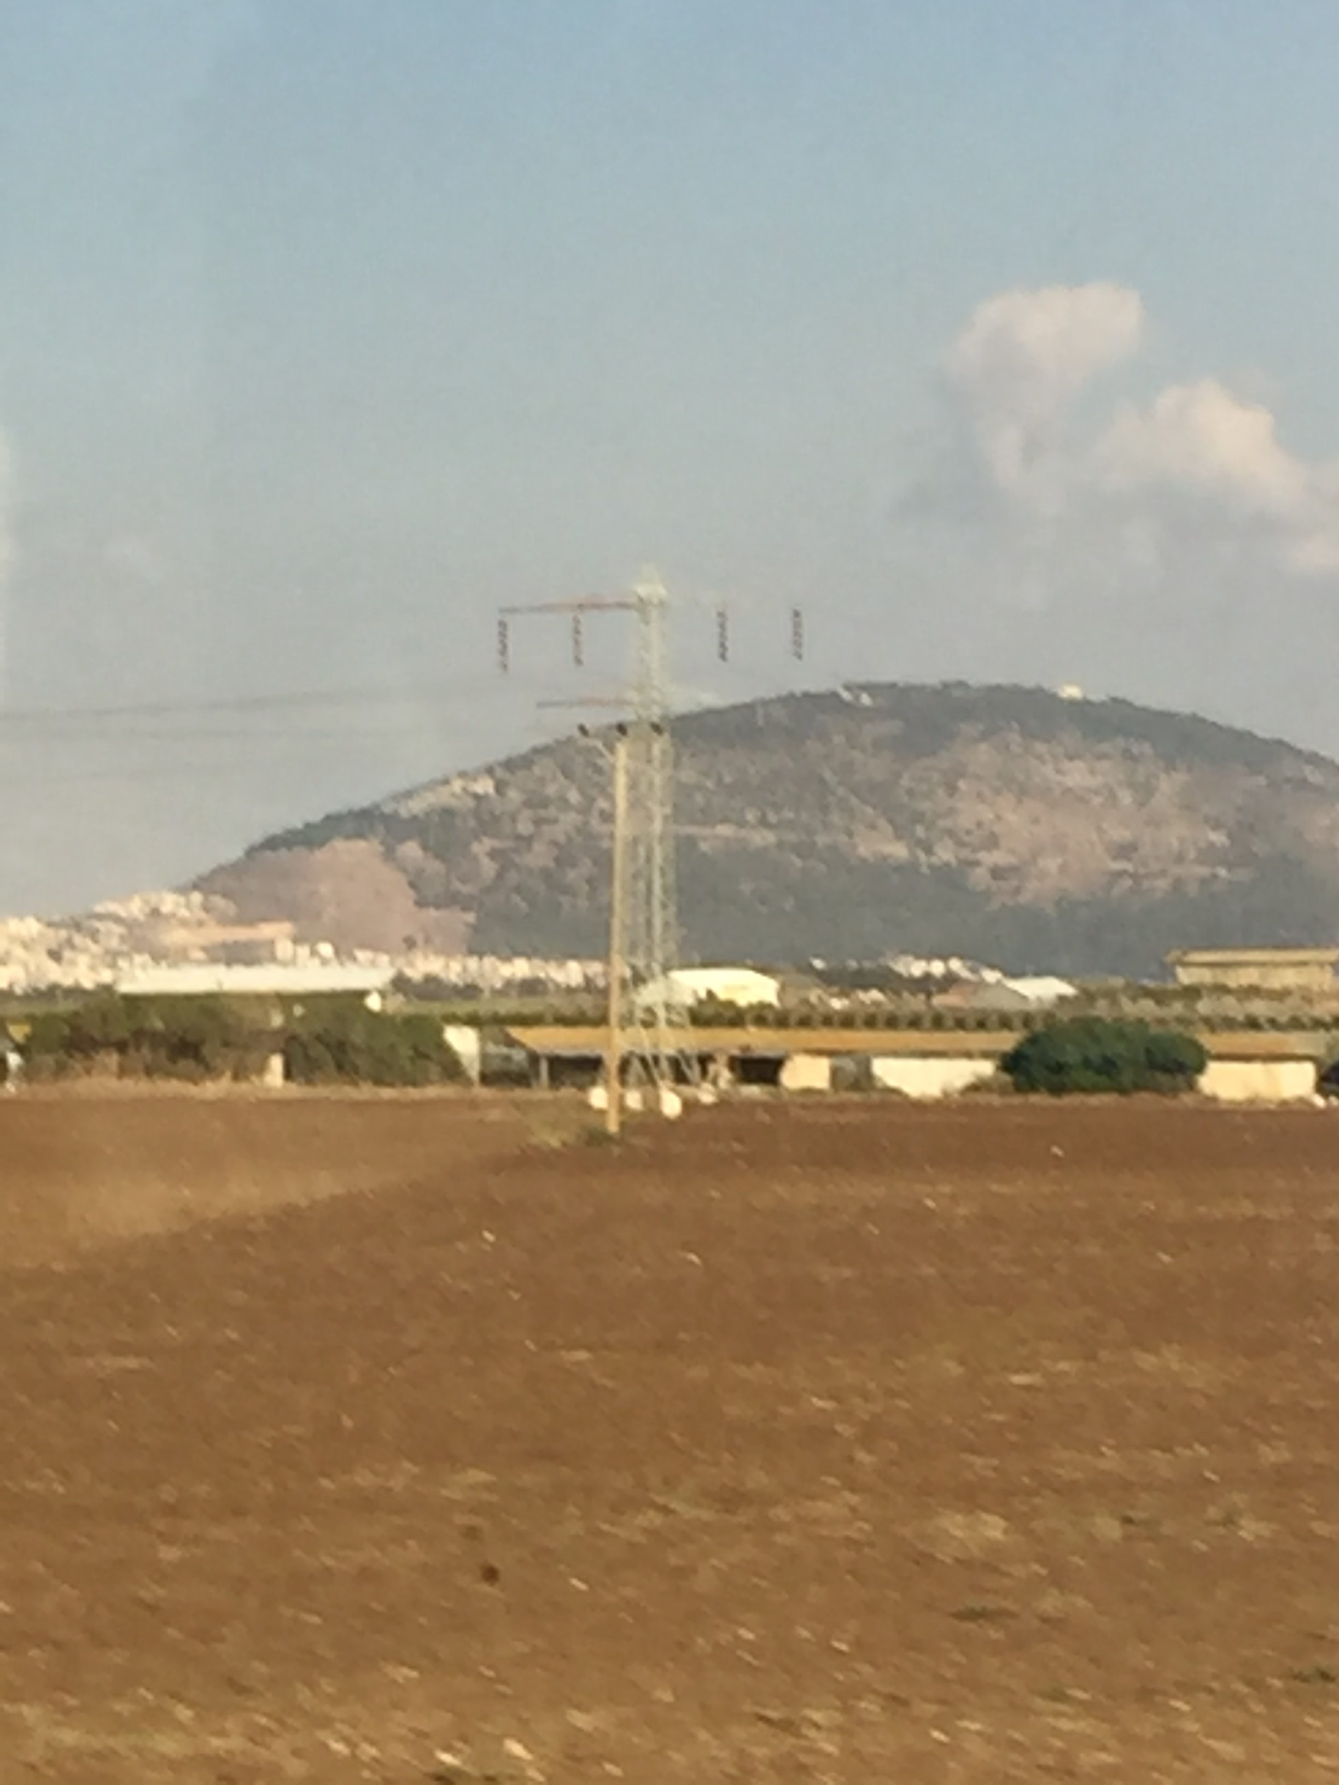
The purpose of Armageddon: 1) To humble the nation of Israel 2) To set in motion the events to fulfill the Abrahamic covenant for the nation of Israel 3) To remove the scales of blindness from the eyes of the Jews so that they will accept Jesus as the Messiah & Savior 4) To bring to an end to the ‘times of the Gentiles’ Ezekiel 38- 39 Gog and those with him will invade the Middle East & come to Israel (Dan 11:16,41) “and it shall come to pass at the same time when Gog shall come against the land of Israel, saith the Lord God,, that my fury shall come up in my face”…… (Ezekiel 38:18-19,23).. …of the many nations, and they shall know that I am the LORD.
Mt Tabor
(Possible the Mt of transfiguration – Matt 17
In history many armies have marched
through Jezreel (Armageddon) valley Gen 49 (Issachar.) Judges :Deborah, Barak & Gideon guided by God.
Saul perished here.
Pharaoh, Assyrians, the British etc

Slide 37
Timescale (random) | Man’s Responsibility | Man’s failure & the consequences | Observations
Return of Christ to the Great White Throne Judgement – One thousand years | Man is to obey and submit to the King and also to worship Him | a) Man gives feigned obedience, and still has a choice. b) The result of Satan kingdom is complete destruction by fire | Millennium will not begin until after Christ 2nd return to the earth. Rev 20:6. KING of KINGS and LORD of LORDS. Rev 1: 5-6 / I Tim 6:15 Rev 11:15. Christ reigning with his Saints. War will be abolished, idolatry will end. Every false religion will be gone. Judgement of the living nations Matthew 25: 31-66 Israel Zech 8:23 Satan loosed after a 1000 years Rev 20: 7-9 Whoever was not found written in the book of Life was cast into the lake of Fire Rev 20: 15. The cometh the end 1 Corinth 15: 24- 26 – Eternity. The New Jerusalem.
Dispensation of the Kingdom

Slide 38
Eternity:
Physical changes will take place, passing away of the first heaven and the first earth,
we will enter a new dimension that we cannot yet comprehend.
Scripture provides the following references :-
There will be a new heaven and a new earth with no sea (Rev 21:1)
The holy city, the New Jerusalem, will come down from God out of heaven (Rev 21:2)
The tabernacle of God will be with people on the new earth (Rev 21: 3)
There will be no more death, sorrow, crying, or pain (Rev 21:4)
There will be a new paradise (Rev 22: 1-5)
There will be a new source of light (Rev 22:5)
Only for believers will inhabit and inherit this kingdom of Rev 21:7
“He that overcometh shall inherit all things; and I will be his God, and he shall be my son.”
And in contrast v 8
“But the fearful, and unbelieving, and the abominable, and murderers, and whoremongers, and sorcerers, and idolaters, and all liars, shall have their part in the lake which burneth with fire and brimstone: which is the second death.”

Slide 39
Summary insights:
Dispensations | Each dispensation ends in a world crises | God comes down
Innocence | Expulsion | Garden of Eden
Conscience | The Flood | God talked with Noah
Human Government | Confusion of tongues | God said ‘ Let us go down’
Promise | Bondage of the chosen race | Burning bush
Law | The crucifixion of Jesus Christ | Incarnation of Christ
Grace | The rapture of the church | The Lord shall descend
Tribulation | The binding of Satan | 2nd coming to Earth
Kingdom | Fire from Heaven Rev 20: 7-9 | Still upon earth
God has always protected His people before judgement fell. ☺

Slide 40
References:
Bible, K.J., 1996. King James Bible.
Hall, J.L. and Bernard, D.K., 1993. Doctrines of the Bible. Ch The Last Things by J Urshan, Word Aflame Press.
Henry, M., 2010. The New Matthew Henry Commentary: The Classic Work with Updated Language. Zondervan Academic.
Lalonde, P., 1991. One World Under Antichrist. Harvest House Pub.
Lee, R., 1982. The Outlined Bible. Zondervan Publishing House.
Rasmussen, C., 2010. Zondervan Atlas of the Bible. Zondervan.

